Slide 1
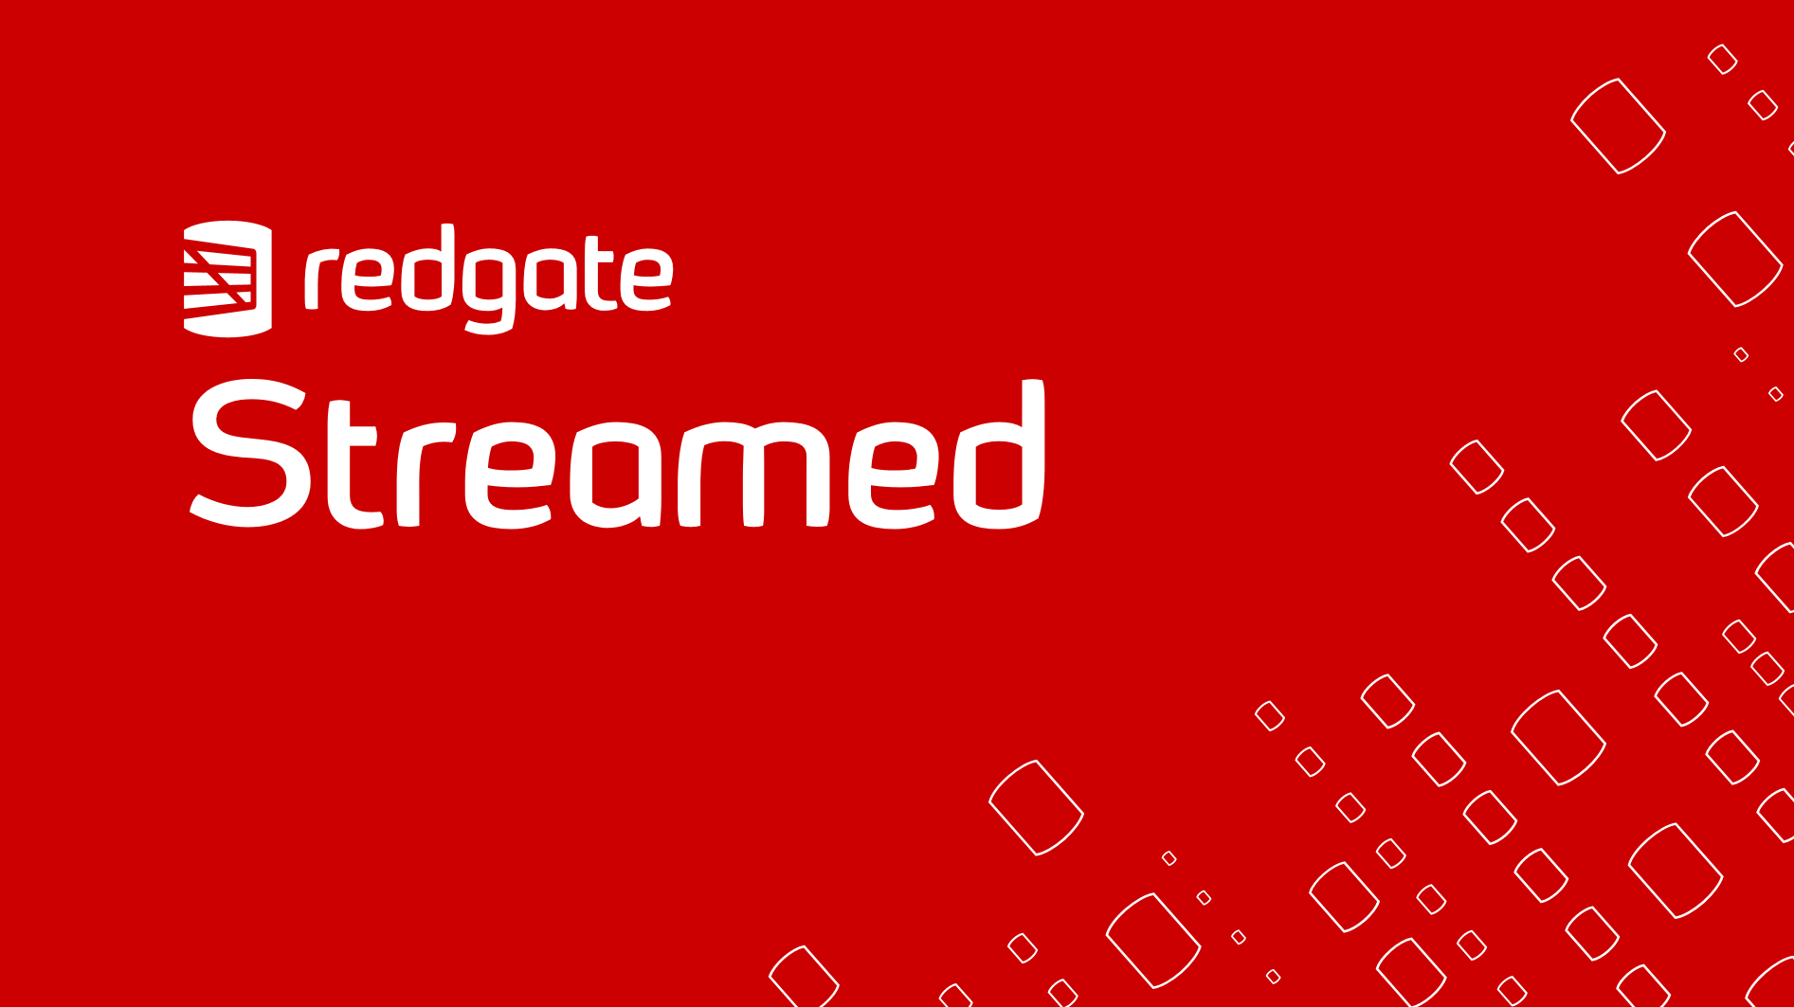

SQL Server DevOps:
Getting Started

Slide 2


Audience
Want to automate but don’t know where to begin

Slide 3
Agenda
What choices do I need to make?
What tools are out there?
What hurdles will I face?
Demo
Questions

Slide 4
Purpose
Know your options
Know where to start

Slide 5
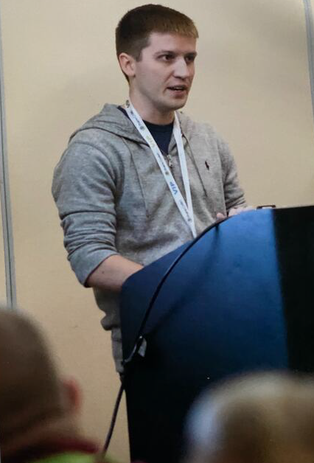


About me
Scott Sauber
Software Consultant
Developer (not DBA)
Friend of Redgate
Automated over 50 DB’s
@ScottSauber

Slide 6
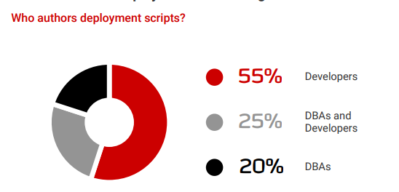
Manual Workflows with DB’s
Devs write, review, deploy SQL
Devs write, DBA reviews and deploy SQL
DBAs write, review, deploy SQL

Slide 7
Why is manual painful?
No Source Control
Humans
Dev DB + Prod DB out of sync
Notes:
No Source Control
No traceability
No easy rollbacks
Comments are not source control
Manual
Tediuous
Prone to error
Development DB + Prod DB could be out of sync
This means changes behavior for your applications
Overwriting others works (sprocs, views, functions, etc)
Hard to pull in others changes because there is no forced CI

Slide 8
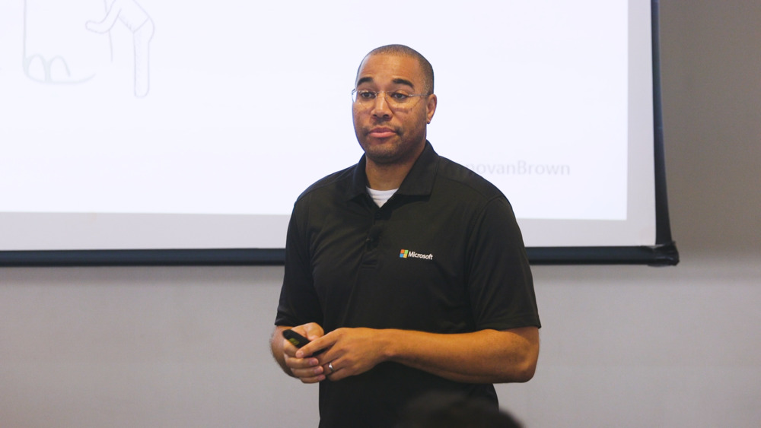
What is DevOps?
“DevOps is the union of people, process, and products to enable continuous delivery of value to our end users.”
Donovan Brown
Microsoft

Slide 9
What is DevOps?
“DevOps is the union of people, process, and products to enable continuous delivery of value to our end users.”
Donovan Brown
Microsoft

Slide 10
What is DevOps?
“DevOps is the union of people, process, and products to enable continuous delivery of value to our end users.”
Donovan Brown
Microsoft

Slide 11

What is DevOps?
“You can’t change culture and process with a credit card.”
Julie Gunderson
PagerDuty

Slide 12
Basic Desired Outcomes of SQL Server DevOps Pipelines
Database in source control
Database deployments at most 1 click of 1 button
Database builds to verify each commit

Slide 13
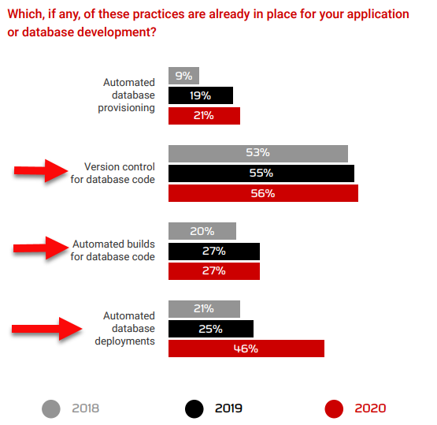

Slide 14
Why is this hard?
Source control not first class in default SQL Tools
Sins have been committed in your legacy databases
Requires Devs + DBA’s to actually talk to each other
DBA’s think they’re getting cut out (spoiler: they’re not)
Database is stateful, applications are not
Rollbacks require thought

Slide 15

…but how?

Slide 16
Source Control: What?
Schema Structure
Tables, Views, Stored Procedures, all DDL
Static Data
Data needed for the application to run
Ex: Lookup tables, roles, configuration

Slide 17
Source Control: How?
Migration based
Every change is scripted
Scripts committed to source control
Scripts run in order
Tools: SQL Change Automation and Flyway

Slide 18
Source Control: How?
Database Code + Application Code should be in same repo
One PR for app and SQL Code

Slide 19
Tool Review: Flyway by Redgate
Open source
CLI Tool
Migration-based
Supports versioned migrations and repeatable

Slide 20
Tool Review: Redgate SQL Change Automation
Also supports showing final state of DB
Visual Studio and SSMS Extension
Integrates with MSBuild, Azure DevOps, TeamCity, Octopus Deploy, and others

Slide 21
Automated Builds: How?
Deploy migrations to independent DB as test run
Use Build Tool
Azure DevOps, GitHub Actions, TeamCity, Jenkins, Bamboo, etc.

Slide 22
Automated Deployments: How?
Deploy migrations to each Environment
Swap out secrets (connection strings)
Use Deployment Tool
Azure DevOps, Octopus Deploy, a Build Tool, etc.

Slide 23
Proposed Workflow – Starting Point
Developer adds their application code and SQL Code
Developer sends PR
Another Developer reviews application code
DBA/senior reviews SQL code
When both approved, code is merged into your main branch
Code is built independently to verify commit
Deployments are a single button click

Slide 24
Workflow Demo
with Azure DevOps

Slide 25
Common Gotcha’s
You will pay for the sins of your ancestors
Linked Servers
Cross DB Hopping
Fully Qualified Database Names
No named column defaults

Slide 26
Rollbacks
Not worth the headache
Context. How do you rollback a DELETE or TRUNCATE?
Restore from backup, but lose data between deploy and restore
Instead: Roll forward

Slide 27
People Challenges
Mindset Shift
The more you can force “no one has Prod” the better
Force everything to go through the pipeline
Devs + DBA’s need to work together
Customer focus

Slide 28
Takeaways
Awareness to tools available to you
Source Control your DB
Auto Build and Deploy those Source Controlled Migrations
Gotcha’s – tools, existing DB sins, people

Slide 29
You CAN do this.
The only question is…
Does your organization want to?

Slide 30
Resources
Redgate Simple Talk Blogs
Redgate Database DevOps Blogs
Redgate 2020 State of DevOps Survey

Slide 31
Questions?
@ScottSauber
scott@saubersoftware.com

Slide 32
Thanks!
@ScottSauber
scott@saubersoftware.com

